Slide 1
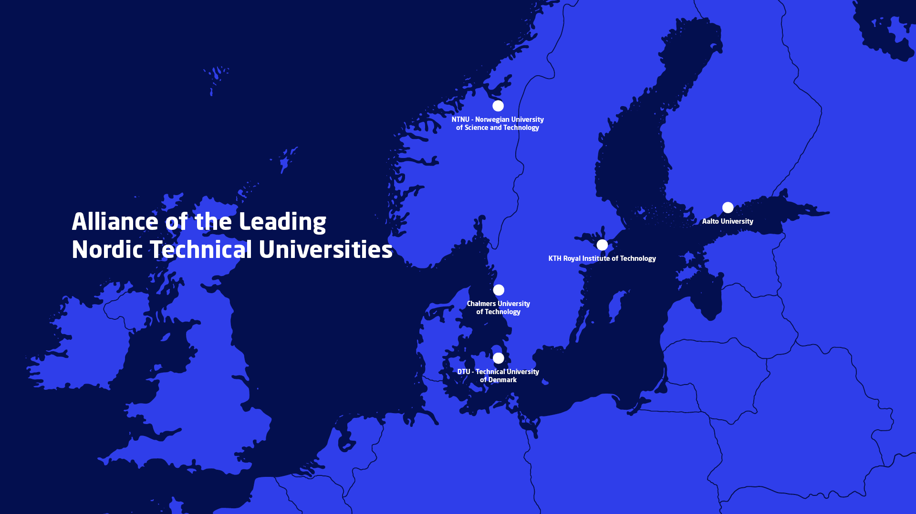
Nordic Five Tech Action Plan 2026-2027
Nordic Five Tech is a strategic alliance of the five leading technical universities in Denmark (DTU), Finland (Aalto), Norway (NTNU) and Sweden (Chalmers, and KTH)
The alliance was established in November 2006 with the goal of utilizing shared and complementary strengths and creating synergies within education, research and innovation

Slide 2

2026-2027: Action plan
N5T has been active since 2006 and is currently evolving as an alliance to meet new societal and academic needs. This action plan is a continuation of the plan for 2025-26 that was developed following input from all five universities. The action plan has been approved by the N5T Committee.
In the current geopolitical situation, overarching guiding principles for our collaboration should be the prevalence of the Nordic countries and important shared values such as democracy and human dignity.
Main points:
Focus on presence and visibility – N5T should be a perceptible and influential alliance in the Nordic and European knowledge policy development and have a presence in international policy dialogue
Develop collaboration on defence research and education
Continue to work on education offers in a broad sense: Collaborative offers on all levels, mobility and communication of offers
Focus on innovation, entrepreneurship and deeptech
Creation of a joint academic leadership development program

